Slide 1
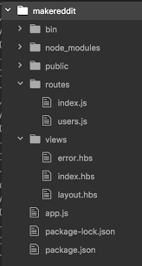

Slide 2
Not practical

Slide 3
No reusability

Slide 4
Grouped by nidam script

Slide 5
Routes files are bad

Slide 6
No routes files

Slide 7
Inheritance

Slide 8
Featured modules

